Slide 1
Heat recovery feature
Competitive approach

Slide 2
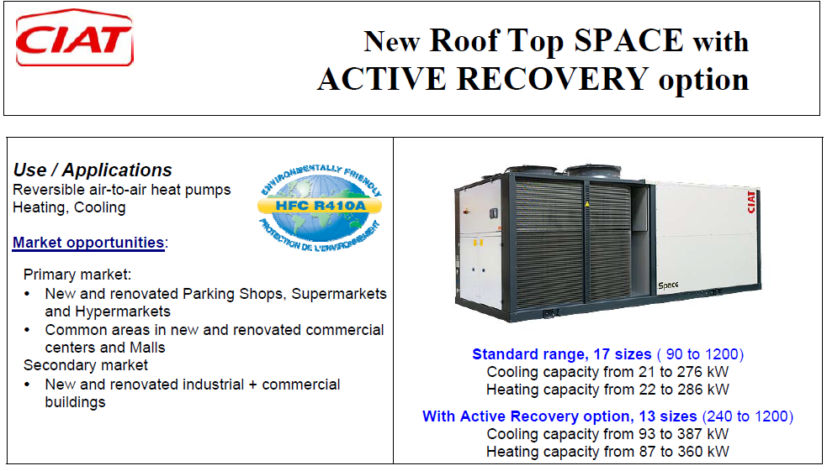
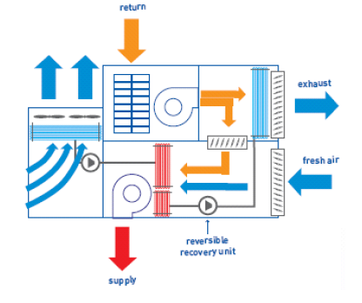
CIAT – “Active” recovery
Below 20% of Fresh Air :
  No recovery
  Less cooling and heating capacities

Slide 3
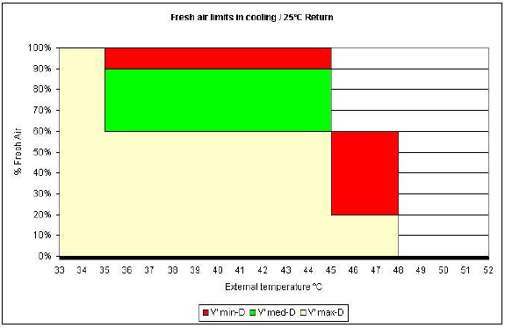
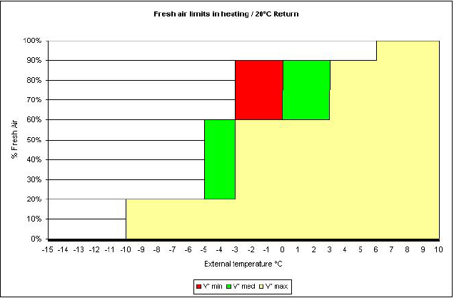
CIAT – “Active” recovery
Operation limits
Above 60% of Fresh Air :
  Only Medium & Low air flows supported

Slide 4
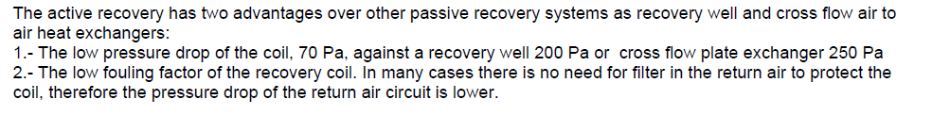
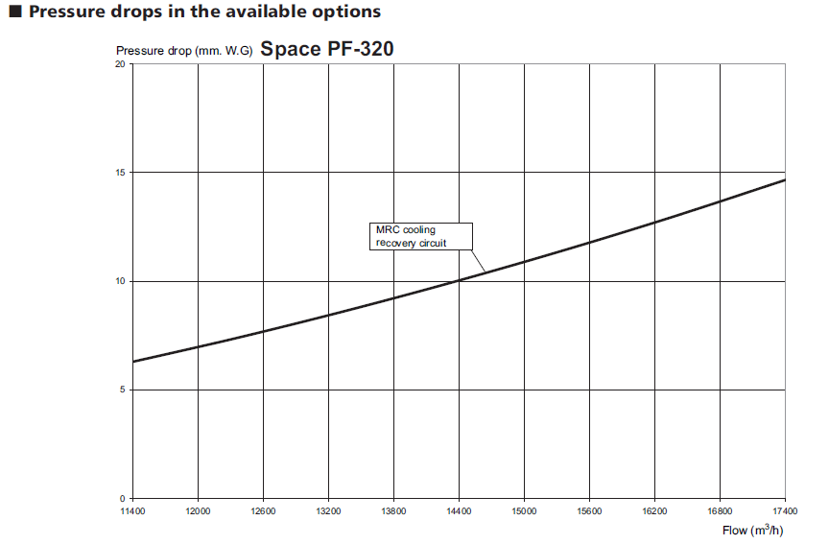
CIAT – “Active” recovery
CIAT argument
135 Pa
Total Return ESP = Return duct network pressure drops + 135 Pa

Slide 5

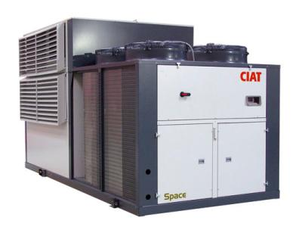

CIAT – “Active” recovery
YES
NO
Efficiency ???

Slide 6
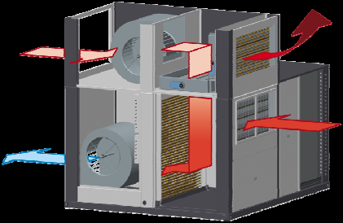
CIAT – “Active” recovery
Exhaust & Fresh Air on same side:
  High risk of mixture
  Not allowed in some countries
Return fan (not Exhaust):
  No modulation with FA %
  Higher consumption
Plug fan (AC) or centrifugal return fan :
  But no Inverter
  No return air flow adjustment
YES

Slide 7
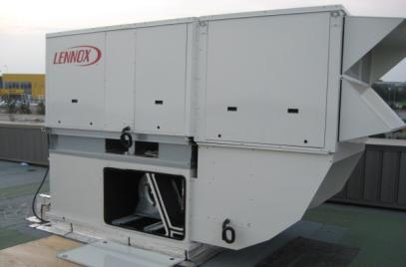
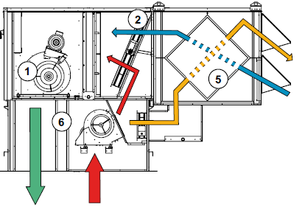
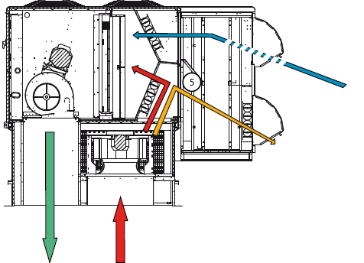

LENNOX
BALTIC III
FLEXY II
YES
Plate heat Exchanger
Efficiency ~ 45%
Rotary Wheel
Efficiency ~ 60%

Slide 8
LENNOX
Comes in 3 parts:
  Not easy to install
Exhaust & Fresh Air on same side:
  High risk of mixture
  Not allowed in some countries
Return fan (not Exhaust):
  No modulation with FA %
  Higher consumption
Plug fan (AC) on return fan of FLEXY II :
  But no Inverter
  No return air flow adjustment
YES

Slide 9
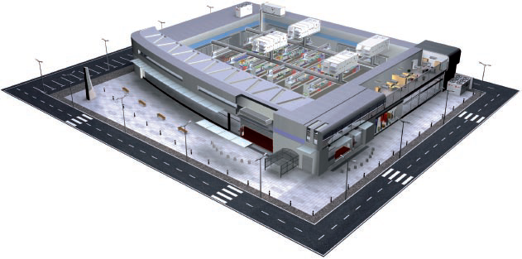
Case study - Hypermarket
Dimensions : 80 x 65 x 6
GLA = 5200 m²
Location = Madrid

Slide 10
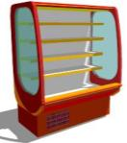



Case study - Hypermarket

Slide 11



Thermal loads - Criteria
Madrid weather data
Summer = 25°C / 50% & Winter = 19°C / 50%
Wall = 0,5 W/m²°C & Roof = 0,3 W/m²°C
Sky domes / 5% of roof
10 m² per customer ➔ 520 customers
30 m³/h of fresh air per person ➔ 15 600 m³/h (4.3 m³/s)
0,5 vol. / h
20 W / m²
2,5 kW
Display cases = 80 m of positive & 24 m of negative

Slide 12
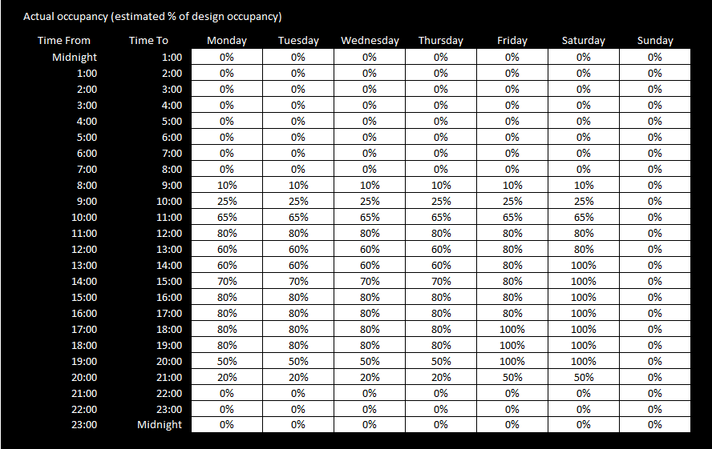
Occupancy Schedule

Slide 13
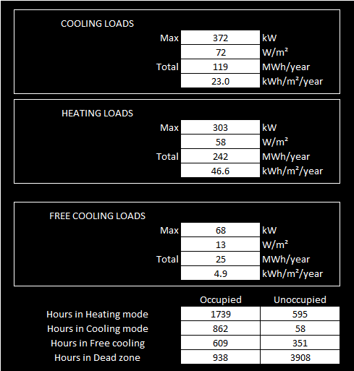
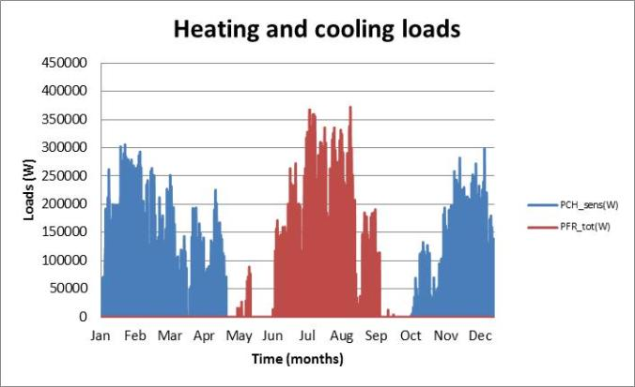
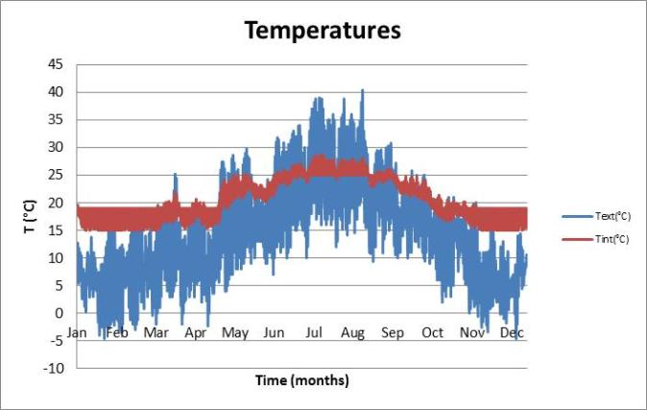
Thermal loads - Results

Slide 14
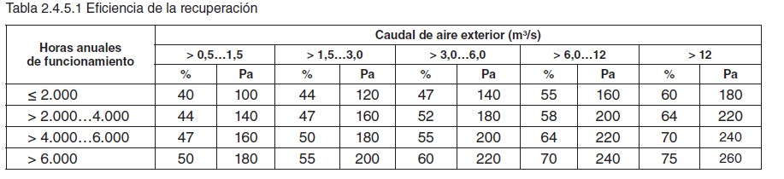
RITE - Expectations

Slide 15
RTU selection
Criteria |  | Total need | If 5 units
Cooling capacity (@ 40°C) | kW | 372 | 75
Heating capacity (@ 0°C) | kW | 303 | 60
Air flow (rotation change) |  | 2.5 | -
Air flow | m³/h | 77500 | 15500
ESP return | Pa | 100 | 100
ESP supply | Pa | 250 | 250
Min. Fresh air rate | % | 20 | 20
Heat recovery |  | Required | Required

Slide 16



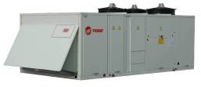
RTU selection
WKD 290
+
ERM (plate heat)
IPF 320
+
MRC (active recovery)

Slide 17
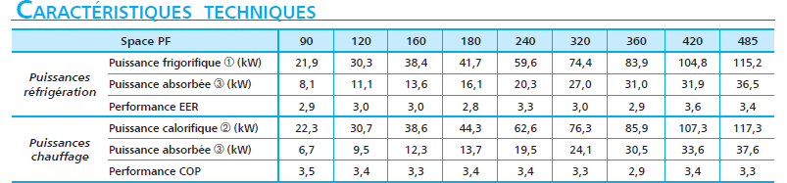
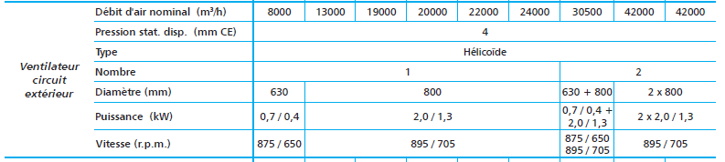
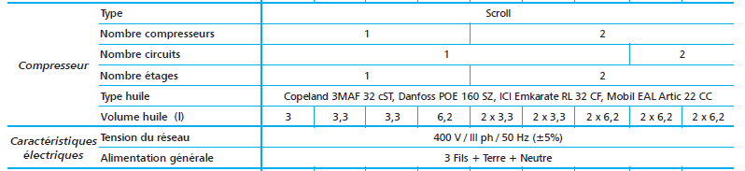
CIAT datasheets

Slide 18
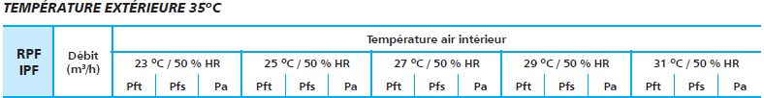

CIAT datasheets

Slide 19
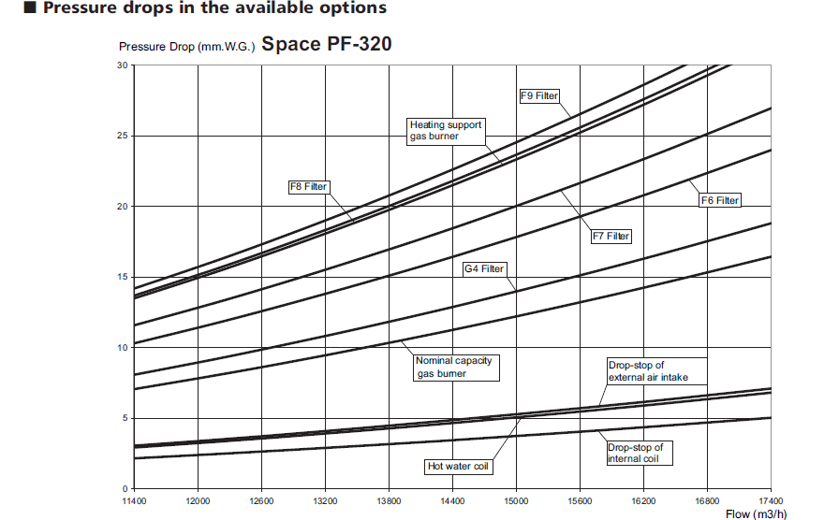
CIAT – Fan curves - Supply
150 Pa
Total Supply ESP = 250 + 150 = 400 Pa

Slide 20
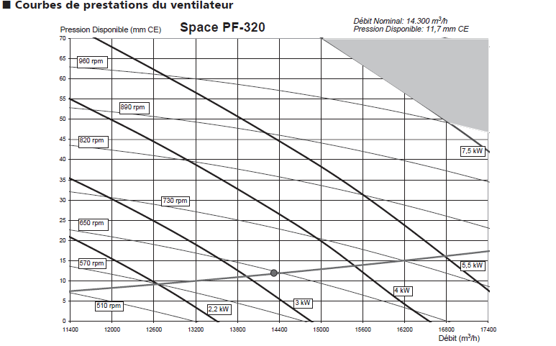
CIAT – Fan curves - Supply
6 kW

Slide 21
CIAT – Fan curves - Return
120 Pa
Total Return ESP = 100 + 120 = 220 Pa

Slide 22
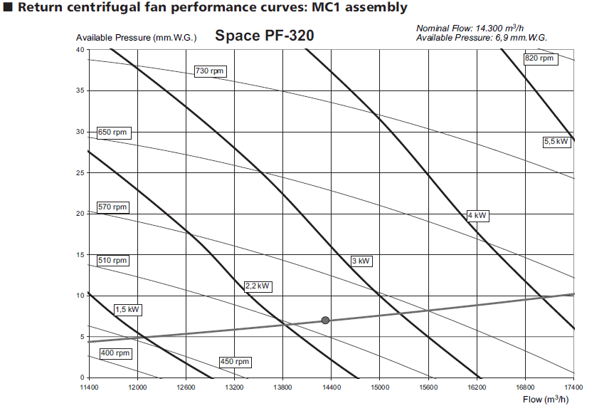
CIAT – Fan curves - Return
220 Pa
3.9 kW

Slide 23
RTU Comparison
Criteria |  |  | TRANE WKD 290 | CIAT IPF 320
Cooling capacity (RTU) | Ext = 35°C / 50% Int = 25°C / 50% | kW | 82 | 72
Cooling capacity (HRM) |  | kW | 7 | 17
Recovery efficiency | Temp. ratio | - | 59% | ?
Cooling capacity (TOTAL) |  | kW | 89 | 89
Heating capacity (RTU) | Ext = 0°C Int = 20°C / 50% | kW | 67 | 66
Heating capacity (RTU |  | kW | 13 | 18
Recovery efficiency | Temp. ratio | - | 62% | ?
Heating capacity (TOTAL) |  | kW | 80 | 84

Slide 24
RTU Comparison
Criteria |  |  | TRANE WKD 290 | CIAT IPF 320
Power abs. | Cp + cd fans | kW | 26.6 | 31
 | Indoor fan | kW | 4.8 | 6
 | Return / exhaust fan | kW | 0.3 | 3.9
Total power abs. @ 20% FA |  | kW | 31.7 | 40.9
System EER |  |  | 2.81 (+30%) | 2.18
Power abs. | Cp + cd fans | kW | 17.8 | 26.5
 | Indoor fan | kW | 4.8 | 6
 | Return / exhaust fan | kW | 0.3 | 3.9
Total power abs. @ 20% FA |  | kW | 22.9 | 36.4
System COP |  | kW | 3.49 (+45%) | 2.31

Slide 25
RTU Comparison
Criteria |  |  | TRANE WKD 290 | CIAT IPF 320
Power abs. in free-cooling 100% FA | Cp + cd fans | kW | 0 | 0
 | Indoor fan | kW | 5.8 | 6
 | Return / exhaust fan | kW | 4.4 | 3.9
Total power abs. in free cooling |  | kW | 10.2 | 9.9
Power abs. in dead zone Max 20% FA | Cp + cd fans | kW | 0 | 0
 | Indoor fan | kW | 4.8 | 6
 | Return / exhaust fan | kW | 0.3 | 3.9
Total power abs. in dead zone |  | kW | 5.1 | 9.9

Slide 26
RTU – Annual consumption
Criteria |  |  | TRANE WKD 290 | CIAT IPF 320
Hours in cooling | 862 | Power cons. (kWh) | 27 325 | 35 256
Hours in heating | 1739 | Power cons. (kWh) | 39 823 | 63 300
Hours in free cooling | 609 | Power cons. (kWh) | 6 212 | 6 029
Hours in dead zone | 938 | Power cons. (kWh) | 4 784 | 9 286
Annual consumption (per unit) |  | kWh / Year | 78 144 | 113 871
Annual running cost (per unit) |  | 1 kWh = 0.111 € | 8 674 € | 12 640 €
Annual running cost savings per unit each year |  |  | - 3 966 €
Annual carbon footprint (in T per unit) |  | 1 kWh = 0.48 kg of CO2 | 37,5 | 54.6
Annual carbon savings per unit each year |  |  | - 17.1 Tons

Slide 27
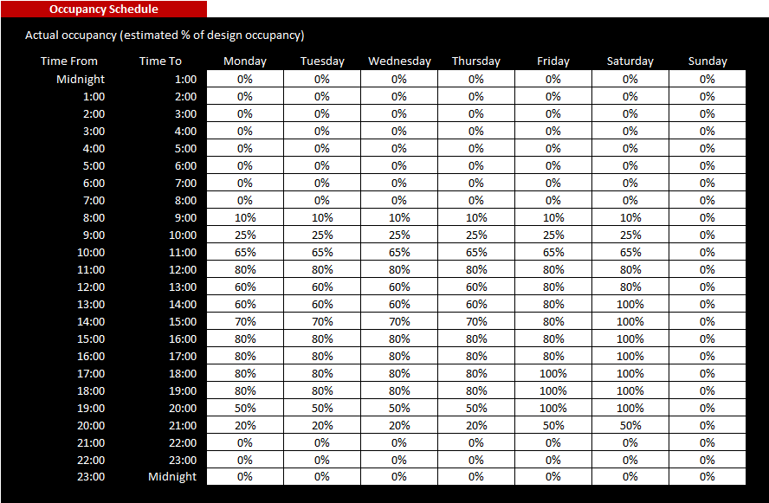

CIAT – Below 20% Fresh AIR
Occupancy Schedule
Fresh Air
20%
Typical Retail
Application
10%
0%
Running time (Year)
15%
60%
25%

Slide 28

More saving…
NO
CO2 sensor
WITH
CO2 sensor

Slide 29
More saving…
Fresh Air
NO
CO2 sensor
20%
0%
Occupancy
50%
100%

Slide 30
More saving…
Fresh Air
WITH
CO2 sensor
20%
SAVINGS
0%
Occupancy
50%
100%
Up to -10% on running cost

Slide 31
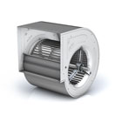

More saving…
Air Flow
rate
6727 kWh = 750 € / Y / Unit
100%
2392 kWh
1430 kWh
2905 kWh
80%
938 h
300 h
562 h
609 h
600 h
1139 h
0%
Running mode
Dead
zone
Cooling
100%
Cooling
Part load
Free
Cooling
Heating
100%
Heating
Part load
Savings = 50% of the fans power supply
=
(4.8 + 0.3) / 2 = 2.55 kW x Hours

Slide 32

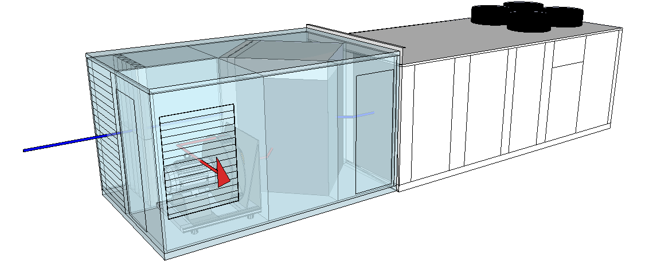
More comparisons…
vs

Slide 33
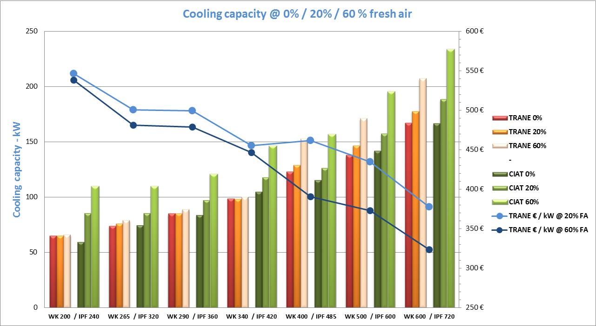
Voyager + ERM vs SPACE + Active recovery
Conditions :
0% FA ➔ Outdoor 35°C - 50% / Indoor = 27°C - 50%
20% & 60% FA ➔ Outdoor 35°C - 50% / Indoor = 25°C - 50%

Slide 34
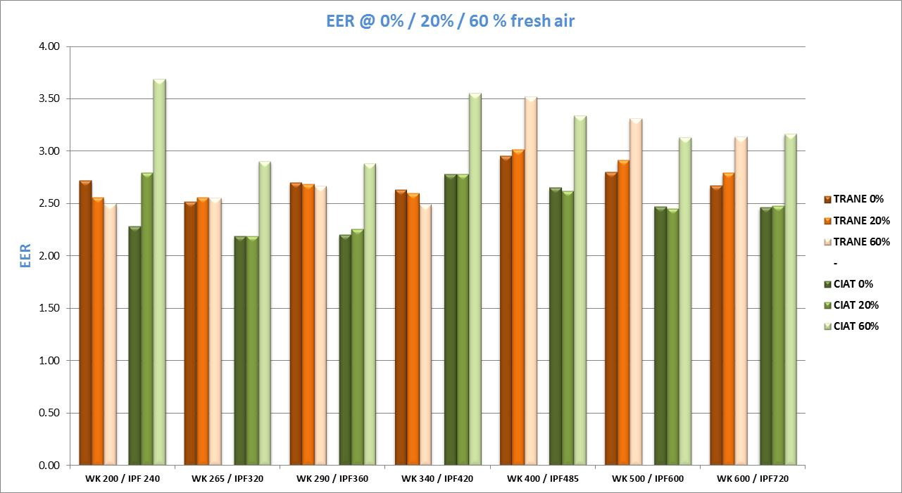
Voyager + ERM vs SPACE + Active recovery
Conditions :
0% FA ➔ Outdoor 35°C - 50% / Indoor = 27°C - 50%
20% & 60% FA ➔ Outdoor 35°C - 50% / Indoor = 25°C - 50%

Slide 35
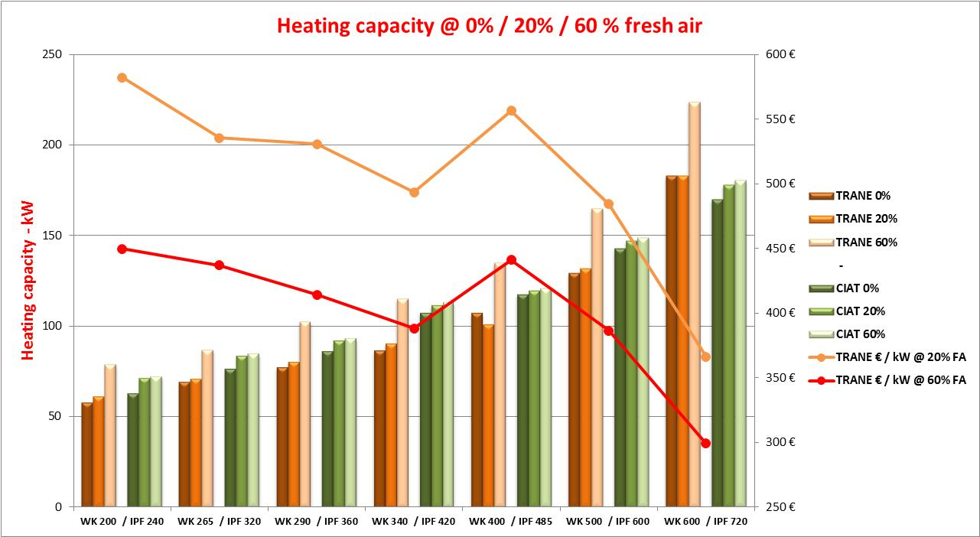
Voyager + ERM vs SPACE + Active recovery
Conditions :
0% FA ➔ Outdoor 6°C / Indoor = 20°C - 50%
20% & 60% FA ➔ Outdoor 0°C / Indoor = 20°C - 50%

Slide 36
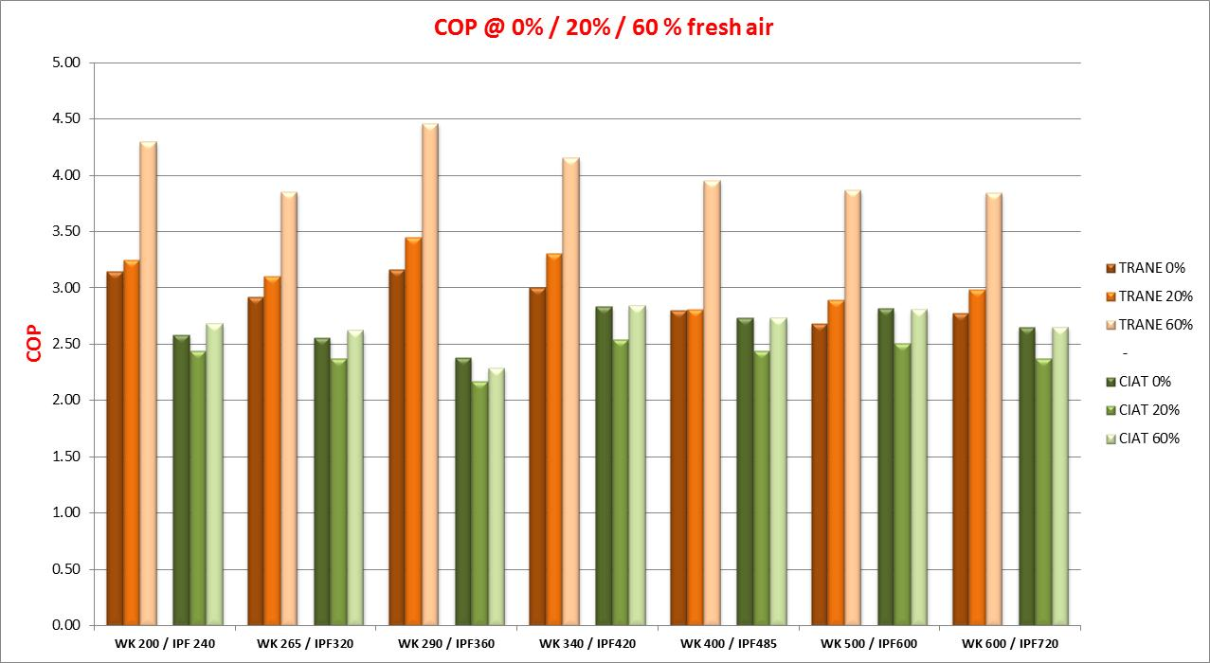
Voyager + ERM vs SPACE + Active recovery
Conditions :
0% FA ➔ Outdoor 6°C / Indoor = 20°C - 50%
20% & 60% FA ➔ Outdoor 0°C / Indoor = 20°C - 50%

